Slide 1
ctDNA-Radiogenomics
Timepoint | t1 | t2
Non-Responders | 2 | 2*
Responders | 9 | 8
14 subjects (3 missing at least one timepoint)
First two timepoints (t1 and t2) subject to analysis
Manual segmentation performed on the series of the highest resolution
Extracted radiomic features within the delineated tumor using PyRadiomics
https://pyradiomics.readthedocs.io/en/latest/index.html
First Order Statistics (19 features)
Shape-based (16 features)
Gray Level Cooccurence Matrix (GLCM, 23 features)
Gray Level Run Length Matrix (GLRLM, 16 features)
Gray Level Size Zone Matrix (GLSZM, 16 features)
Neigbouring Gray Tone Difference Matrix (NGTDM, 5 features)
Gray Level Dependence Matrix (GLDM, 14 features)
2-sample t-Test applied to test the group differences at each timepoint.
* Only one subject has both t1 and t2
Notes:
Features not normalized prior to extraction.
Parameters:
{'distances': [1], 'additionalInfo': True, 'enableCExtensions': True, 'force2D': False, 'interpolator': 'sitkBSpline', 'resampledPixelSpacing': None, 'label': 1, 'normalizeScale': 1, 'normalize': False, 'force2Ddimension': 0, 'removeOutliers': None, 'minimumROISize': None, 'minimumROIDimensions': 1, 'resegmentRange': None, 'padDistance': 5}

Slide 2
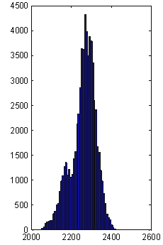
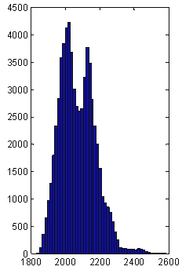
First-order Features
Common statistics extracted from the intensity histogram of the image
min intensity
max intensity
mean intensity
standard deviation
90th percentile
10th percentile
Sum intensity
Entropy
skewness
Kurtosis
…more…
Amadasun et al. IEEE Trans Syst Man Cybern 1989, Materka et al. COST B11 Report 1998

Slide 3
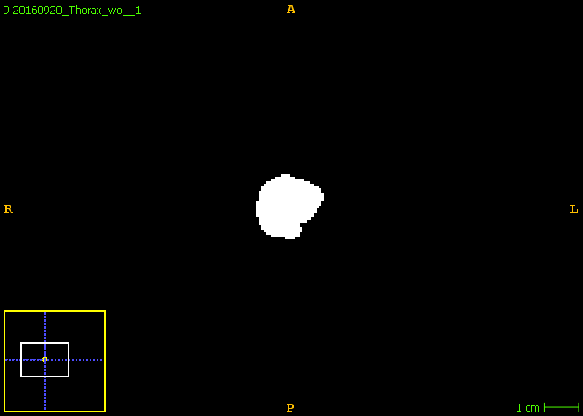
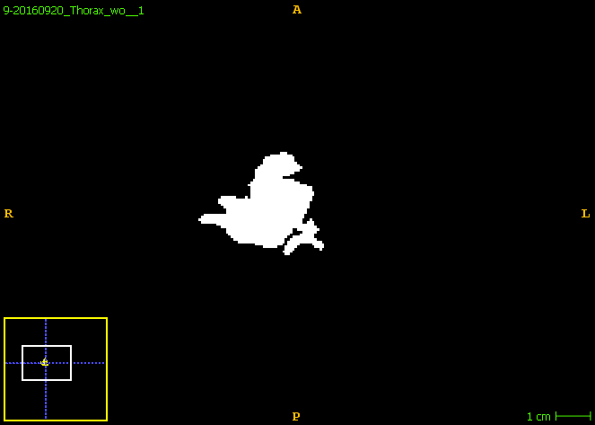
Shape Features
Max Diameters
Compactness
Sphericity
Major/Minor Axis
Elongation
Surface Area
Surface Volume Ratio
Flatness
…more…

Slide 4
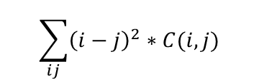
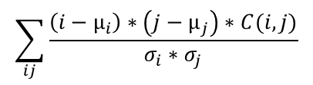
Gray-level Co-occurrence Features
Spatial relationship among gray levels in specified directions
$$\sum_{ij}{\frac{\left(i−µ_{i}\right)∗\left(j−µ_{j}\right)∗C(i,j)}{σ_{i}{∗σ}_{j}}}$$
$$\sum_{ij}{{\left(i−j\right)}^{2}∗C(i,j)}$$
0^{O}
45^{O}
90^{O}
135^{O}
Low contrast
2 | 0 | 0
1 | 1 | 1
3 | 1 | 1
0.17 | 0 | 0 | 0
0 | 0.5 | 0 | 0
0.17 | 0 | 0 | 0
0 | 0.17 | 0 | 0
0 | 0.33 | 0 | 0
0 | 0.33 | 0 | 0.17
0 | 0.17 | 0 | 0
0 | 0 | 0 | 0
3x3 image
with 4 possible gray levels
Gray-level co-occurrence
matrix (C) for 0^{O}
Gray-level co-occurrence
Matrix (C) for 90^{O}
High contrast
(For simplicity, symmetry is not considered here.)
Haralick et al. IEEE Trans Syst Man Cybern 1973

Slide 5
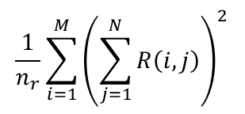
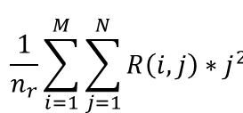
Gray-level Run-length Features
Texture coarseness in specified directions
0^{O}
45^{O}
90^{O}
135^{O}
$$\frac{1}{n_{r}}{\sum_{i=1}^{M}{\left(\sum_{j=1}^{N}{R\left(i,j\right)}\right)}}^{2}$$
2 | 0 | 0
1 | 1 | 1
3 | 1 | 1
1 | 0
1 | 1
0 | 0
0 | 0
0 | 0
2 | 0
0 | 0
0 | 0
$$\frac{1}{n_{r}}\sum_{i=1}^{M}{\sum_{j=1}^{N}{R\left(i,j\right)∗j^{2}}}$$
Run-length
matrix (R) for 0^{O}
Run-length
matrix (R) for 90^{O}
3x3 image
with 4 possible gray levels
(For simplicity, symmetry is not considered here.)
Galloway et al. Comput Graphics Image Process 1975, Chu et al. Pattern Recognit Lett 1990

Slide 6
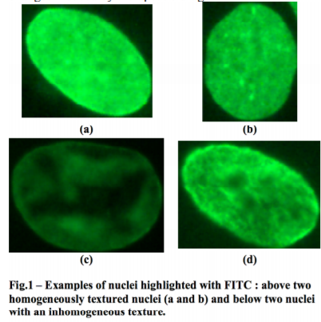
Gray-level Size Zone Features
Texture homogeneity in a region
2 | 0 | 0
1 | 1 | 1
3 | 1 | 1
0 | 1 | 0 | 0 | 0
0 | 0 | 0 | 0 | 1
1 | 0 | 0 | 0 | 0
1 | 0 | 0 | 0 | 0
3x3 image
with 4 possible gray levels
(Rotational invariant)
Guillaume Thibault et. al. “Texture Indexes and Gray Level Size Zone Matrix. Application to Cell Nuclei Classification”. Pattern Recognition and Information Processing 2009.

Slide 7
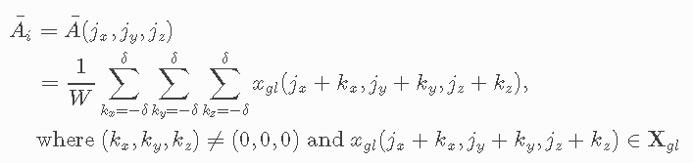
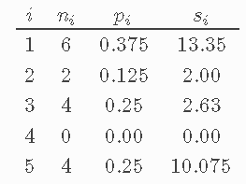
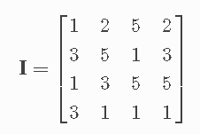
Neigboring Gray Tone Difference Features
quantifies the difference between a gray value and the average gray value of its neighbors within distance δ. The sum of absolute differences for gray level i is stored in the matrix.
Amadasun M, King R; Textural features corresponding to textural properties; Systems, Man and Cybernetics, IEEE Transactions 1989.

Slide 8
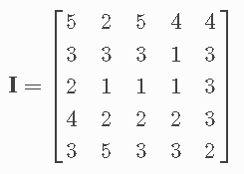
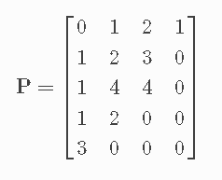
Gray Level Dependence Matrix Features
quantifies gray level dependencies in an image. A gray level dependency is defined as a the number of connected voxels within distance δ that are dependent on the center voxel. A neighboring voxel with gray level j is considered dependent on center voxel with gray level i if |i−j|≤α. In a gray level dependence matrix P(i,j) the (i,j)th element describes the number of times a voxel with gray level i with j dependent voxels in its neighborhood appears in image.
α = 0 and δ = 1
Amadasun M, King R; Textural features corresponding to textural properties; Systems, Man and Cybernetics, IEEE Transactions 1989.

Slide 9
PyRadiomics
First Order Statistics (19 features)
Shape-based (16 features)
Gray Level Cooccurence Matrix (23 features)
Gray Level Run Length Matrix (16 features)
Gray Level Size Zone Matrix (16 features)
Neigbouring Gray Tone Difference Matrix (5 features)
Gray Level Dependence Matrix (14 features)
http://pyradiomics.readthedocs.io/en/latest/features.html

Slide 10
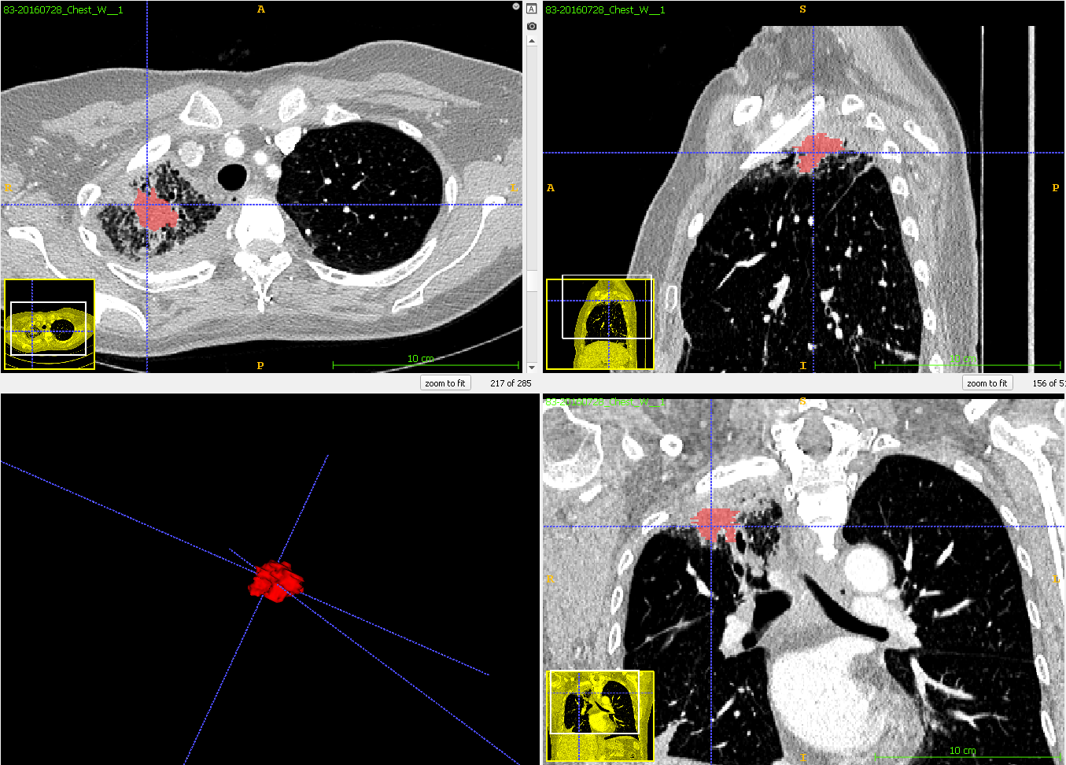
Case 83:
Baseline (t1)
RECIST:
Non-responder

Slide 11
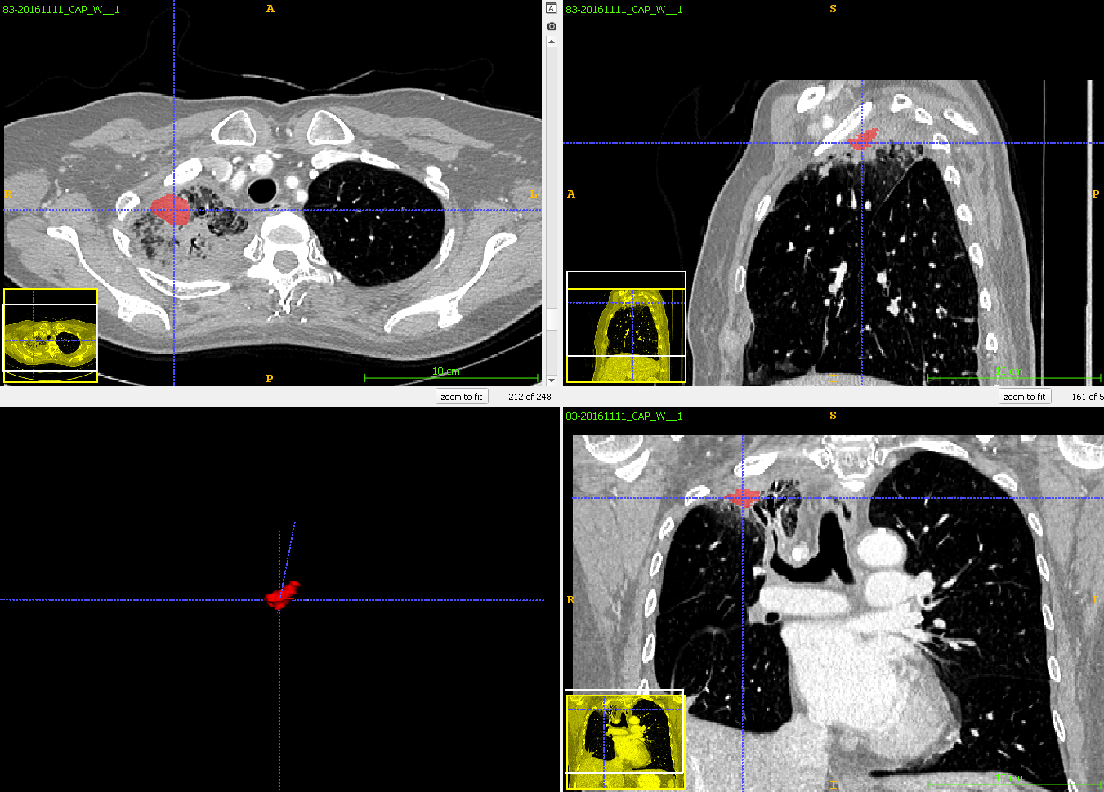
Case 83:
First follow-up (t2)
RECIST:
Non-responder

Slide 12
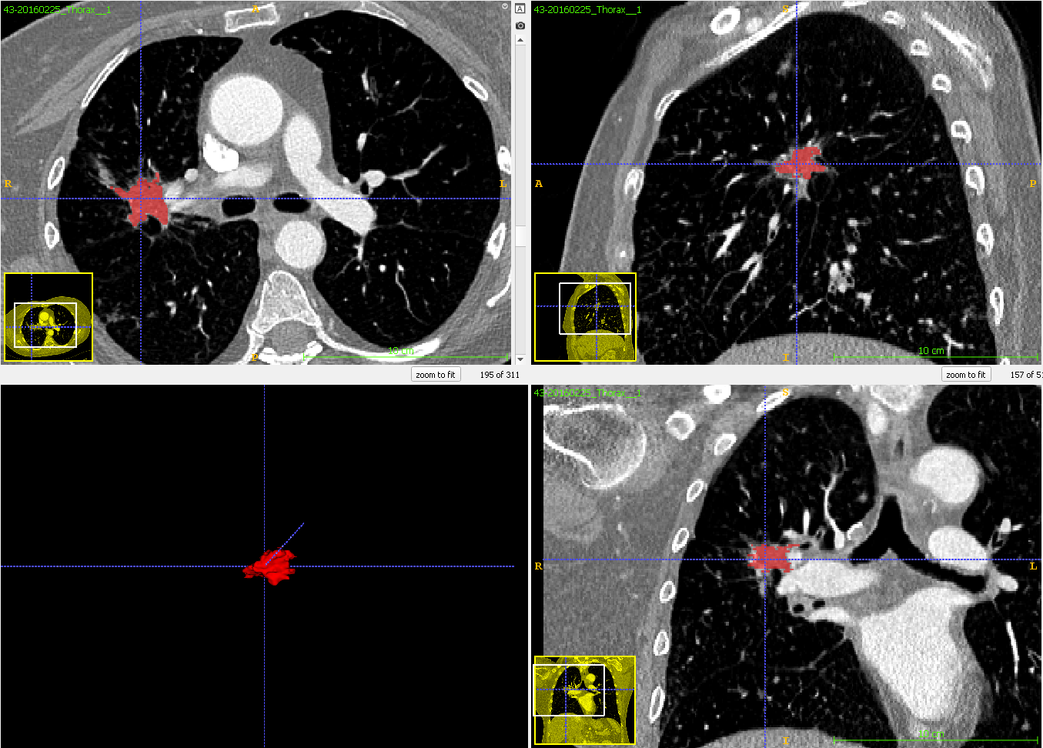
Case 43:
Baseline (t1)
RECIST:
Responder
(Stable)

Slide 13
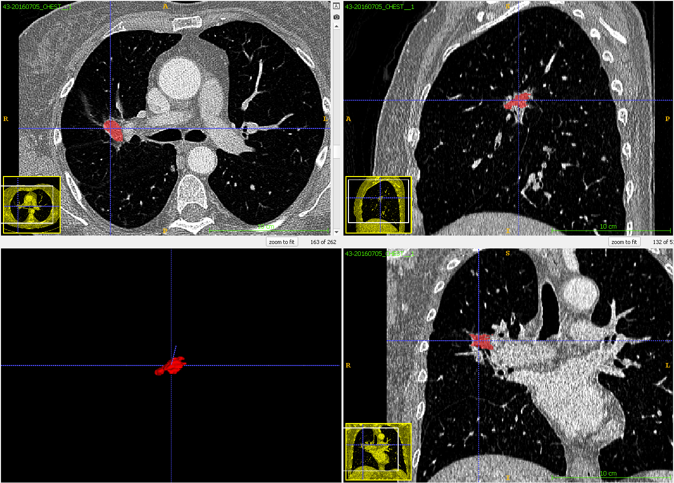
Case 43:
First follow-up (t2)
RECIST:
Responder
(Stable)

Slide 14
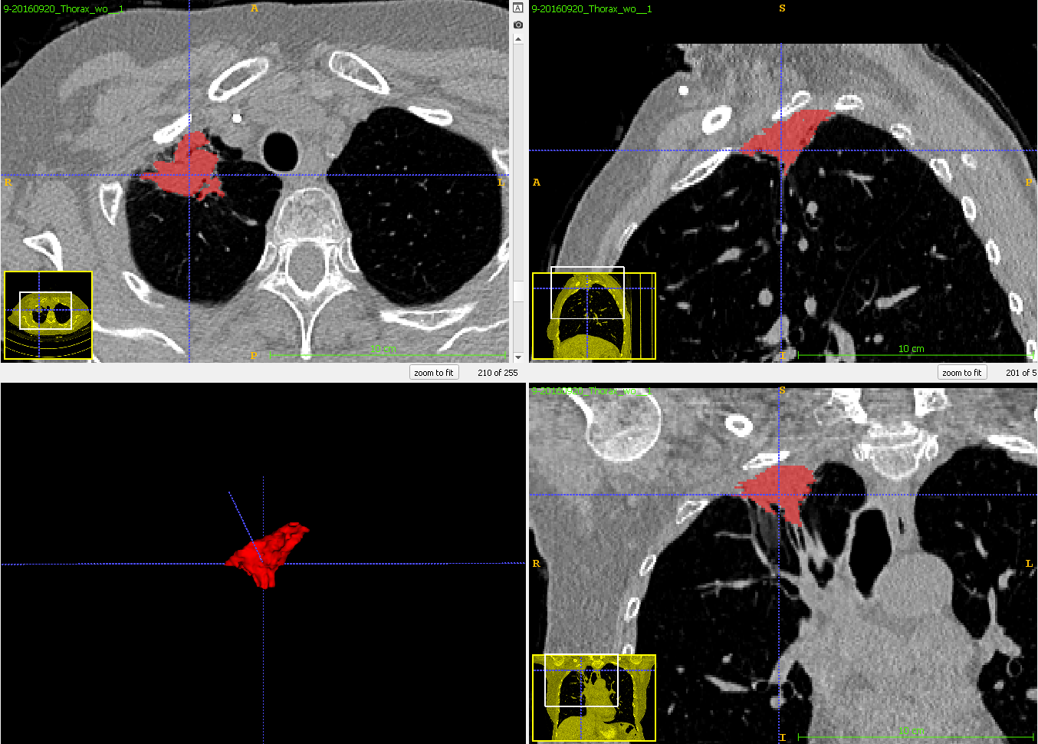
Case 9:
Baseline (t1)
RECIST:
Responder
(Partial)

Slide 15
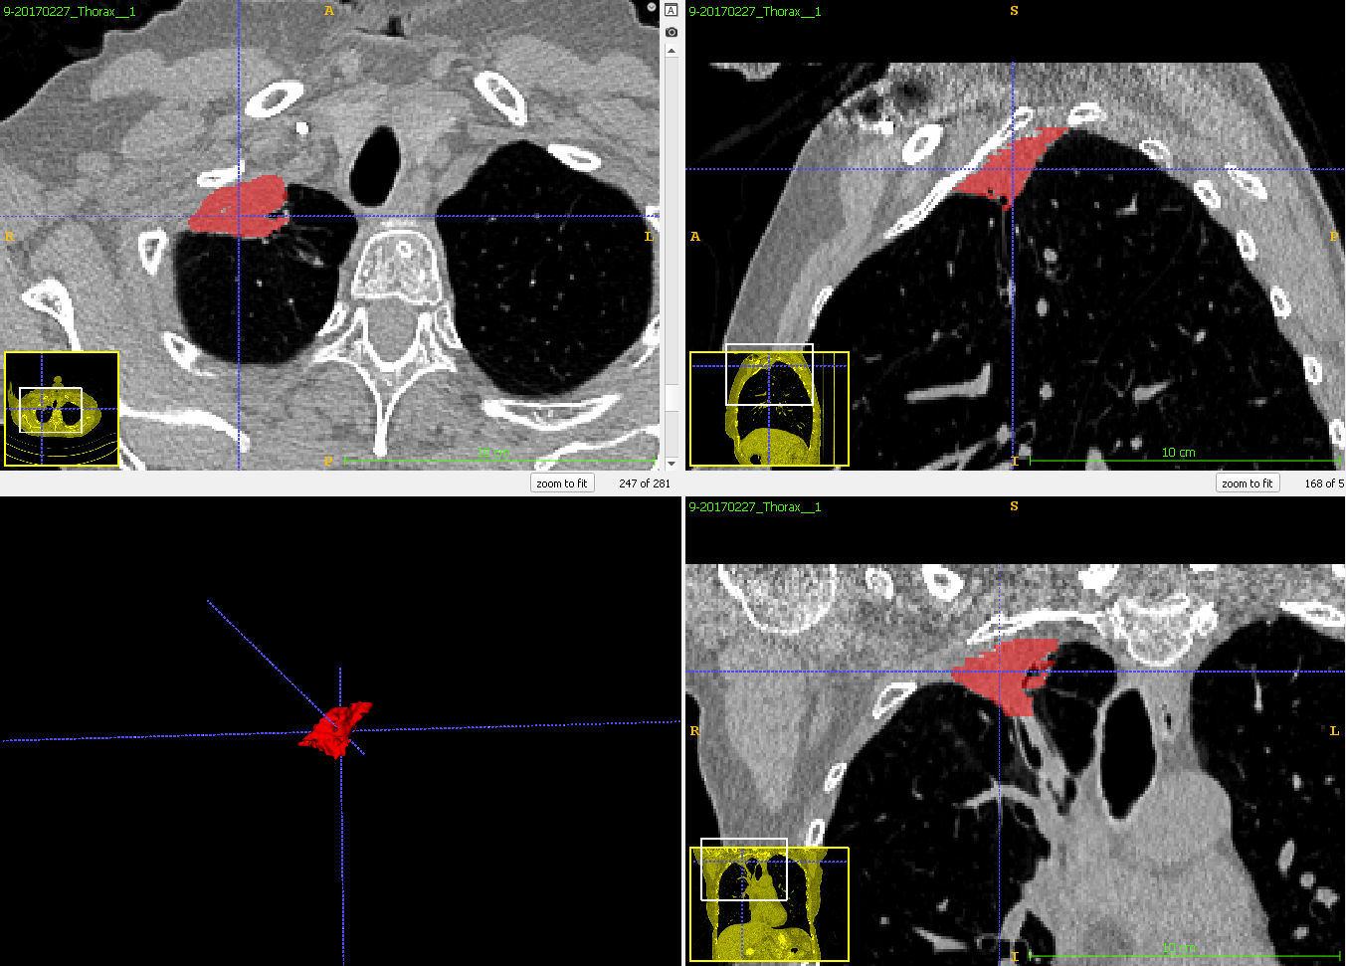
Case 9:
First follow-up (t2)
RECIST:
Responder
(Partial)

Slide 16
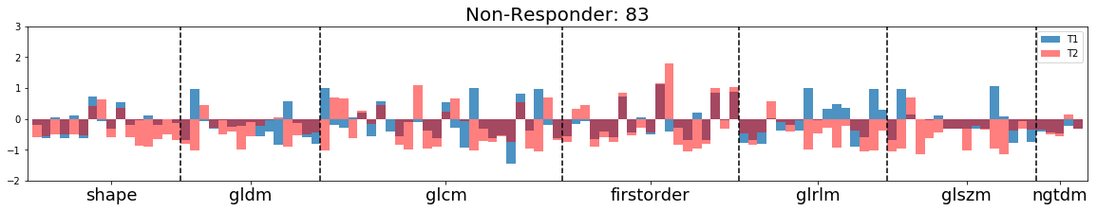
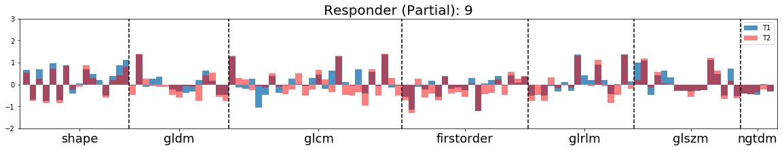
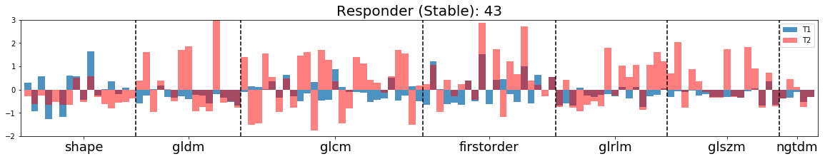
Examples
Of
Normalized
Feature
Vectors

Slide 17
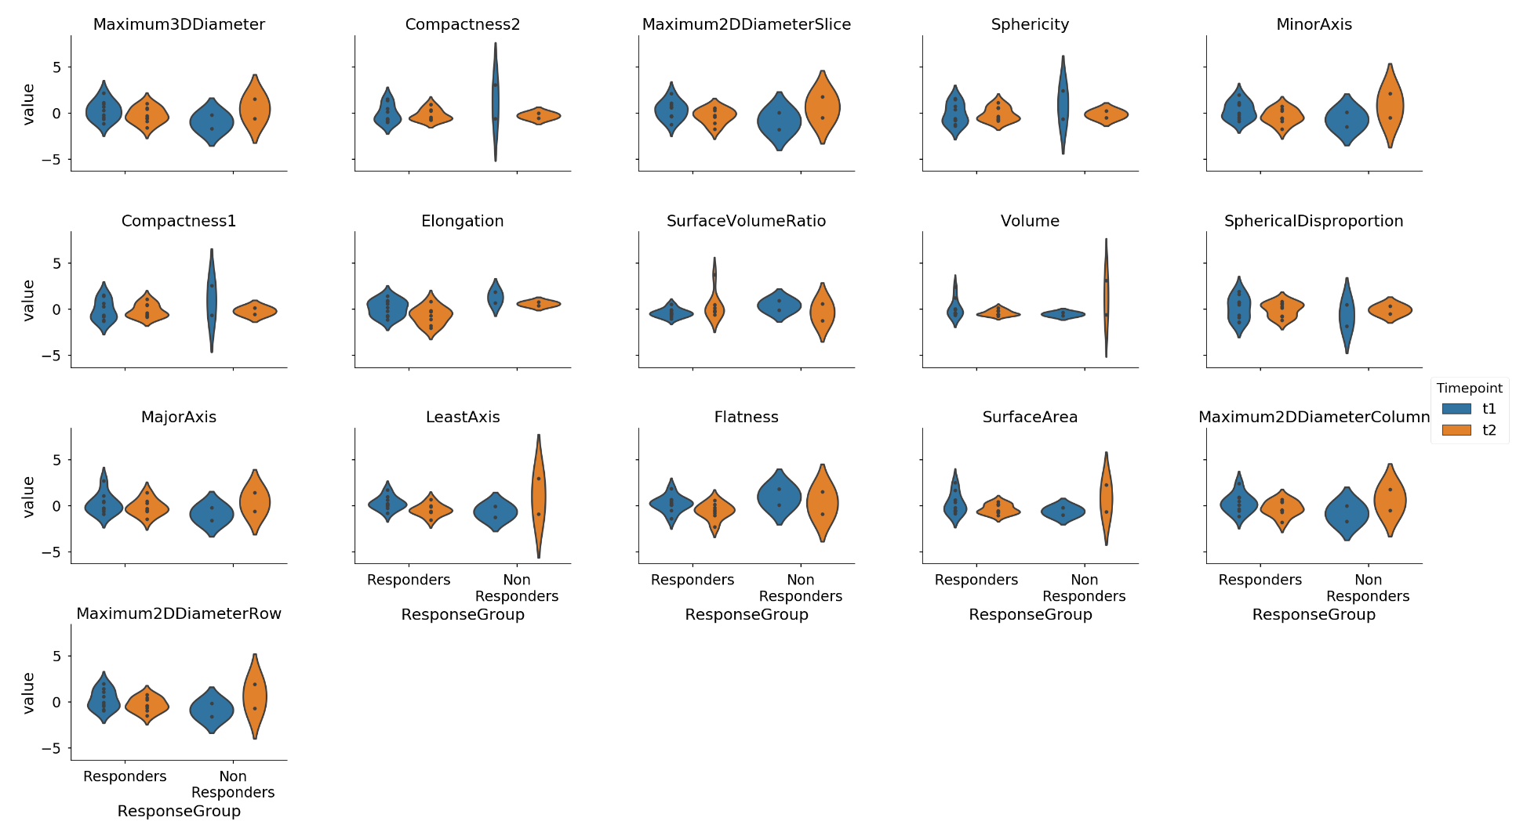
Shape features

Slide 18
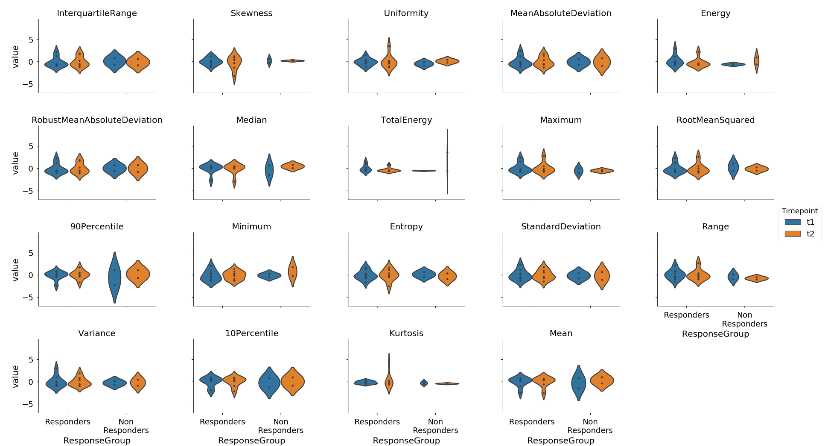
First order features

Slide 19
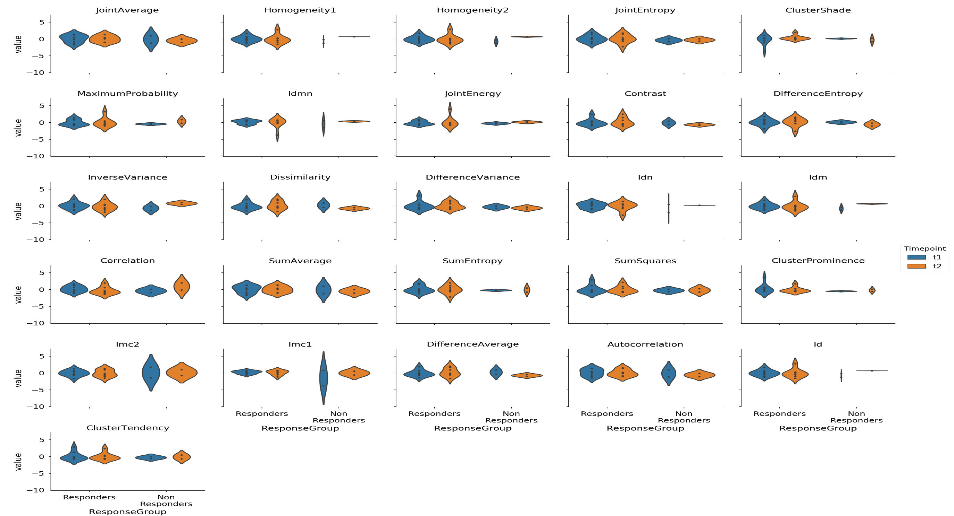
GLCM features

Slide 20
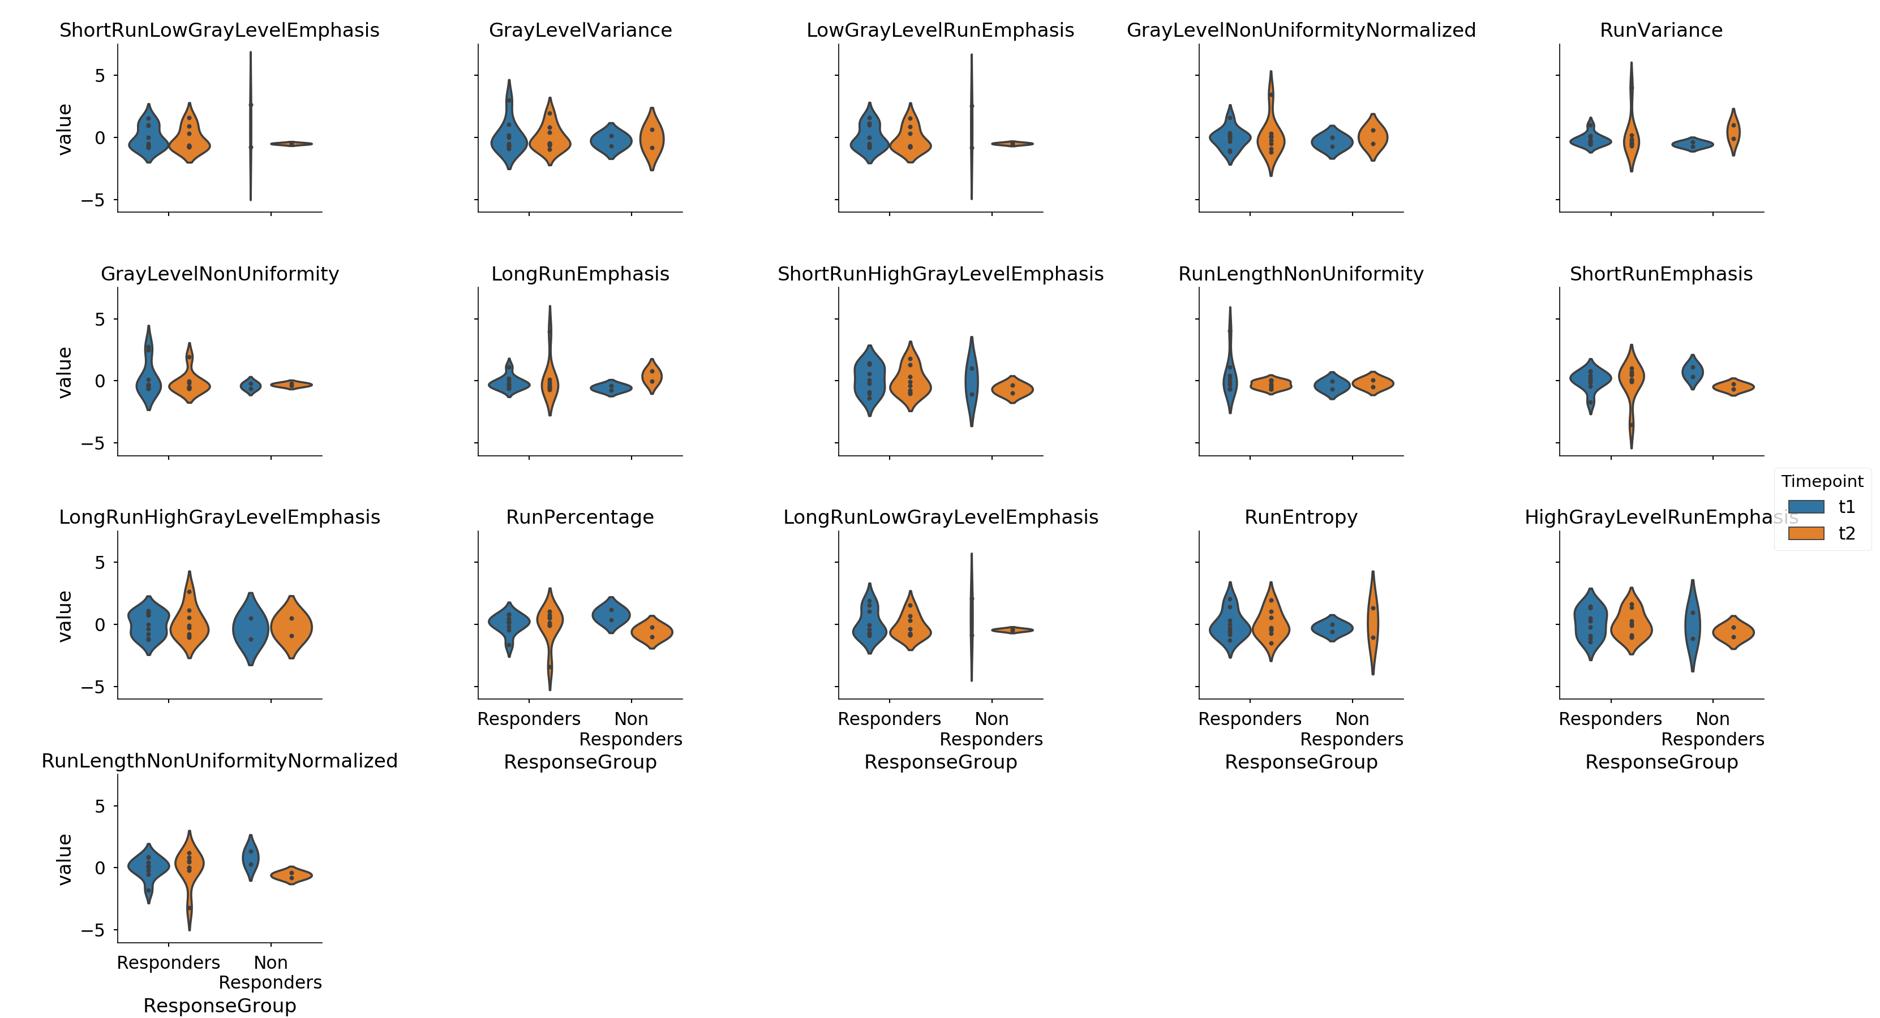
Runlength features

Slide 21
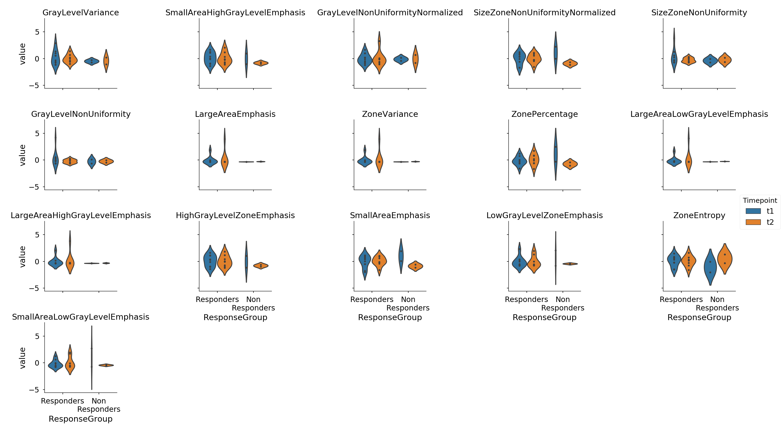
Size Zone features

Slide 22
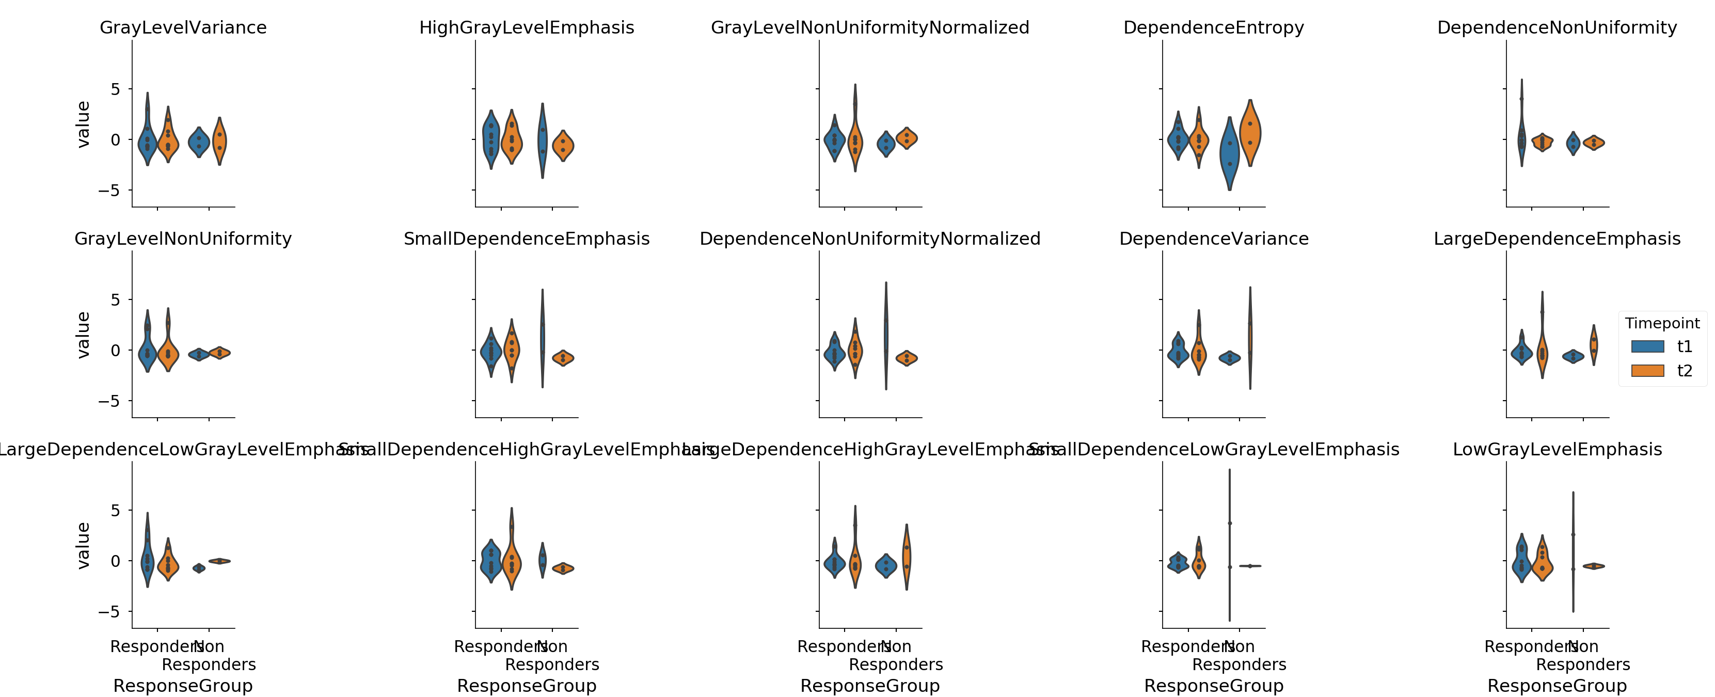
Gray Level Dependence features

Slide 23
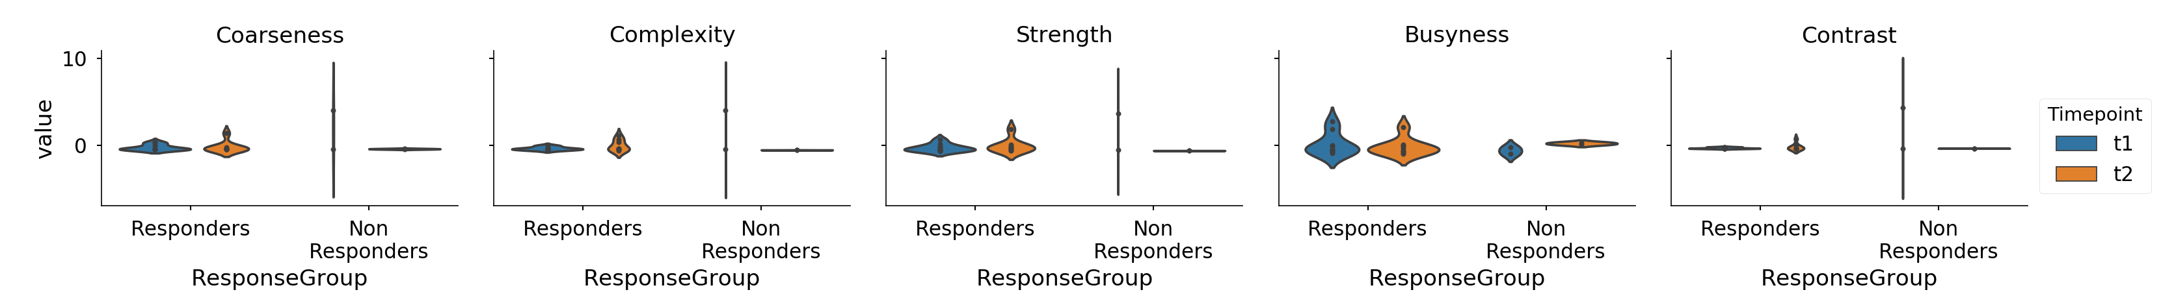
Neigbouring Gray Tone Difference features
*
*
*
* p < 0.05 between responders and non-responders at t1

